Slide 1
DESIGN OF A SMART FIRE DETECTION SYSTEM
DAVID GOSLEE, ISRAEL AKINSOYINU, DEDRICK MCCOY

Slide 2
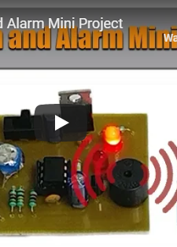
PROJECT INSPIRATION
This was a mini fire detection system found on Nevon Projects.
Detects a fire using a thermistor.
Simple LED and alarm notification.
A good base line device but leaves a lot to be desired.

Slide 3
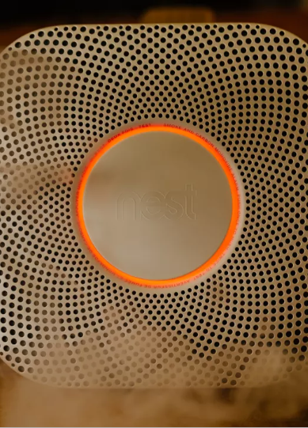
NEST SMART DETECTOR
This is the Nest Project smart fire detector.
Uses a photoelectric sensor and a split-spectrum sensor to detect possible fire threats.
Is equipped with its own app that alerts users when an issue arises.
Can be deactivated via app interface if there is a false alarm.
Prices range from 50 through 180 dollars

Slide 4
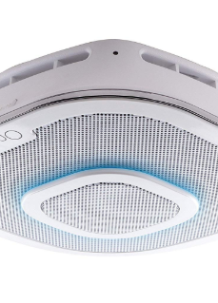
ALEXA ENABLED SMOKE DETECTOR AND CO MONITOR
This is another product that is similar in nature to the project we envision.
Uses photoelectric sensors to detect possible fires.
Comes equipped with a Carbon Monoxide monitoring system.
Compatible with all apple products.
Alexa enabled and uses First Alert OneLink app to notify users.
Prices range from 200 – 270 dollars.

Slide 5
SMART FIRE DETECTION SYSTEM OBJECTIVES
The project goal is to create a smart fire detection system that can be implemented for commercial and in home use.
Determine the fire location i.e. room, floor, or stair well and notify dispatch operators and alert building occupants.

Slide 6
DESIGN REQUIREMENTS
911 call that notifies dispatch of a potential fire and its location within the building.
Detect the temperature of the fire (for flash point).
Monitor Carbon Monoxide levels.
Sms warning message for building occupants.
Must provide output signals for PPE systems (i.e. sprinklers, automatic doors, etc.).
If any module in the system fails, fire alarm controller should detect the fault in 100 seconds.
Fire Detector should mount to existing detectors base mount.

Slide 7
Design Constraints
Voice alarm notification for occupants of structure.
Detector cost should not be more than 200 dollars.
Wireless nodes must be no more than 60 feet apart.

Slide 8
National Industrial Standards
The initiation function provides the input signal to the system (NFPA 101, 9.6.1.7).
The notification function is the means by which the system advises that human action is required in response to a particular condition (NFPA 101, 9.6.1.7).
The control function provides outputs to control building equipment to enhance protection of life (NFPA 101, 9.6.1.7).
Occupant notification shall be by means of voice announcements (NFPA 101, 12.3.4).
Fire alarm circuits shall be installed in a neat workmanlike manner (NFPA 70 Art. 760.24).
Cables and conductors installed exposed on the surface of ceilings and sidewalls shall be supported by the building structure in such a manner that the cable will not be damaged by normal building use (NFPA 70 Art. 760.24).
Smoke detector must be replaced every ten years in accordance to Maryland Smoke Alarm Law.
The smoke alarm requirements for existing older homes are based upon when the house was built.
The Law heavily emphasises the use of sealed smoke alarms with long life batteries and silence/hush buttons.
Any new home in Maryland constructed after January 1, 1989 required at least one hardwired electric smoke alarm on every level of the home, including the basement.
The units must be interconnected in order that activation of any one of the required smoke alarms resulted in the sounding all of the required smoke alarms.
The time from the detector’s issuing a fire alarm signal to the controller’s receiving should be controlled within the 10 seconds (GB4717-2005 Fire Alarm Control Units)
The time from the detector’s issuing a fire alarm signal to the controller’s receiving should be controlled within the 10 seconds (GB4717-2005 Fire Alarm Control Units)

Slide 9
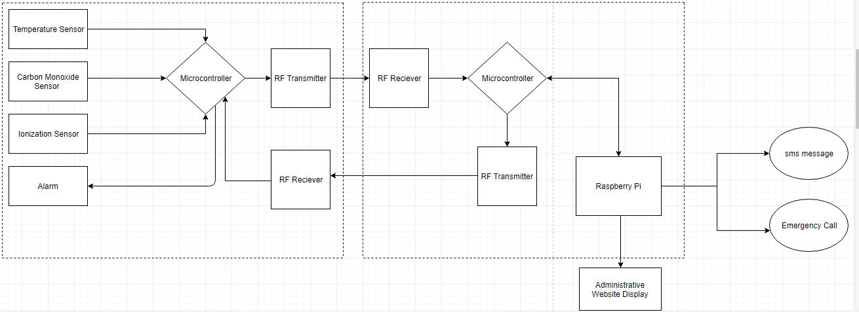
System Diagram

Slide 10
Implementation Plan
Task 1: Sensor Design
1.1: Design program for Temperature Sensor.
1.2: Design program for Carbon monoxide sensor.
1.3: Design program for Ionization sensor.
1.4: Configure arduino with all three sensors.
1.5: Design PCB for transmitter.
1.6: Design PCB for receiver.
Task 2: Wireless Sensor Network Design
2.1: Configure arduino and RF transmitter.
2.2: Design program for arduino and RF transmitter.
2.3 Configure arduino and RF receiver interface.
2.4: Program interface with arduino and RF receiver.
2.5: Configure all sensors with RF receiver and transmitter.
2.6: Configure Raspberry Pi with RF receiver.
2.7: Configure raspberry pi to retrieve and display node data.
2.8: Design program that will interpret and store node data.

Slide 11
Implementation Plan (continued)
Task 3: Website Design
3.1: Design background and layout of website.
3.2: Design login for administrator and user access.
3.3: Program a grid layout that will assign each node ID to its own room.
3.4: Design a program that will pair node ID with corresponding room on grid plan.
3.5: Program grid layout such that the area of the grid where the threat is located is highlighted.
Task 4: Configure raspberry pi and website
4.1: Design program that will transmit and display WSN data on webpage.
4.2: Design program that will display warning messages from pi on webpage.
4.3: Configure node ID’s with building grid layout.
4.4: Program alarm system shut off for administrative use.
Task 5: Automated Phone Call System Design
5.1: Setup pivlo account and install software on raspberry pi.
5.2: Configure PIVLO with wireless sensor network.
5.3: Design Virtual Alert message for each specific node ID.
5.4: Design program that will allocate node ID numbers to specific automated dispatch message.
5.5: Program each specific node ID for a specific SMS message transmission.

Slide 12
Implementation Plan (cont.)
Task 6: Design Warning Message Database
6.1: Design database that will contain building occupant phone numbers.
6.2: Configure database with SMS message warning protocol.
6.3: Design a program that will send building occupants a link to webpage.
Task 7: System Assembly and Testing
7.1: Assemble entire system.
7.2: Test full platform with nodes placed in their appropriate positions.
7.3: Test warning systems and ensure they give proper threat location.

Slide 13
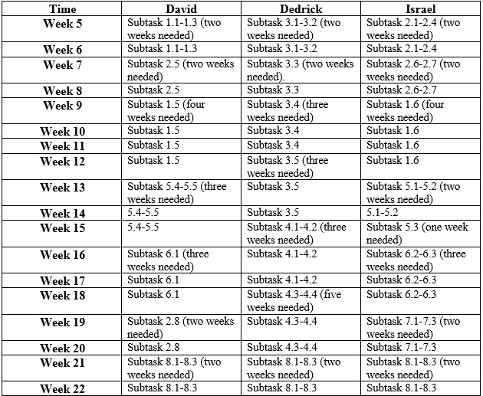
Implementation Timeline

Slide 14
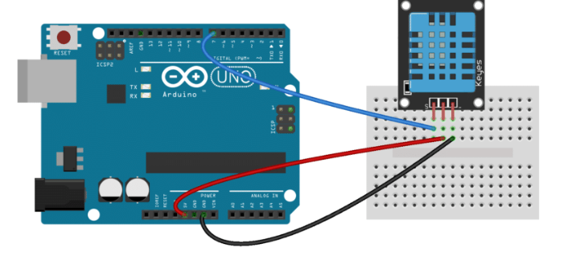
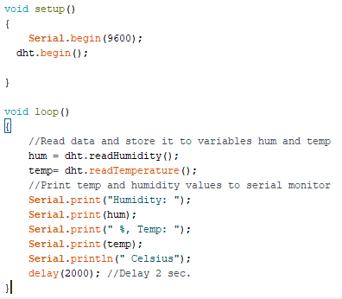
Implementation (Subtask 1.1) Circuit Design and program for DHT22 temperature Sensor

Slide 15
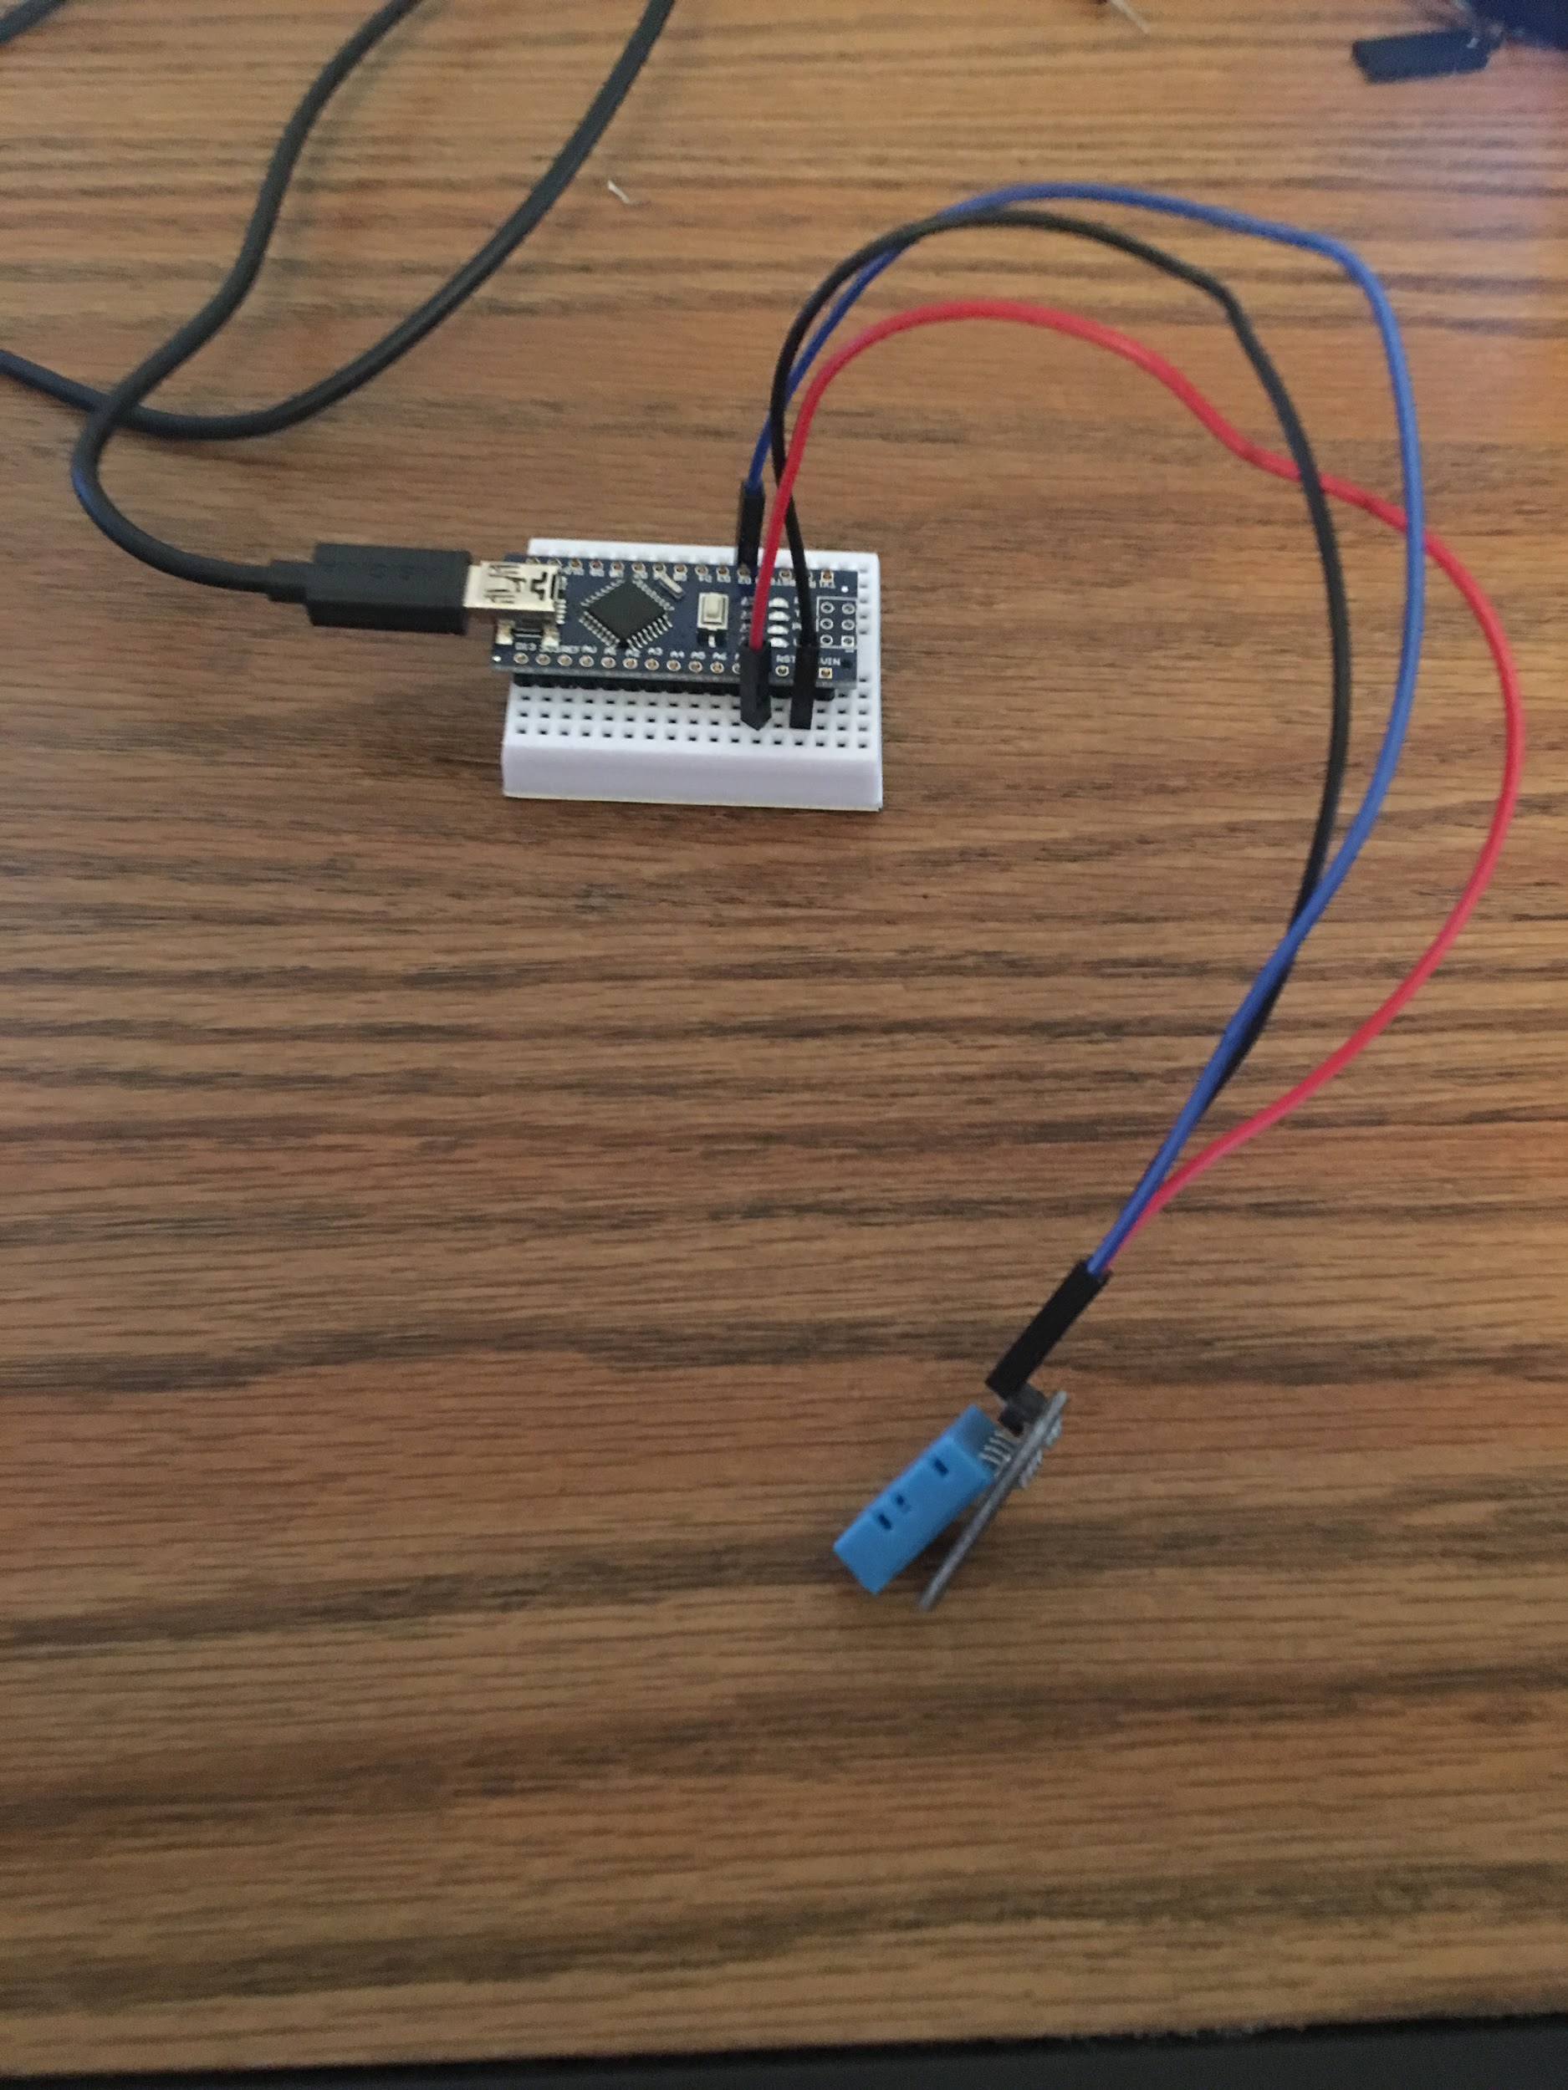
Implementation (Subtask 1.1) Circuit Design and program for DHT22 temperature Sensor

Slide 16
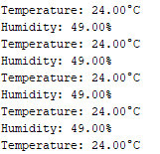
Subtask 1.1 (output)
Output displays both temperature and humidity.
Only temperature is sent to the RF transmitter.

Slide 17
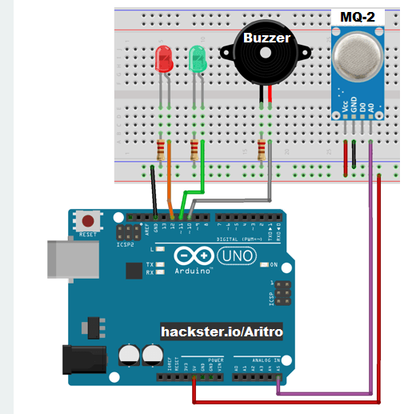
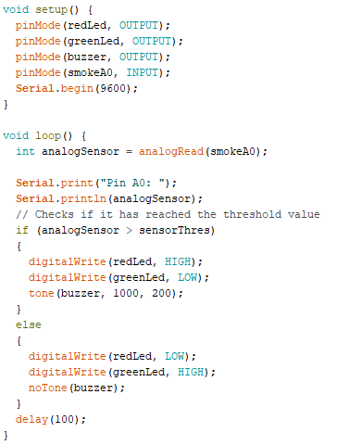
Implementation (Subtask 1.2) Design circuit and program for MQ-2 ionization sensor

Slide 18
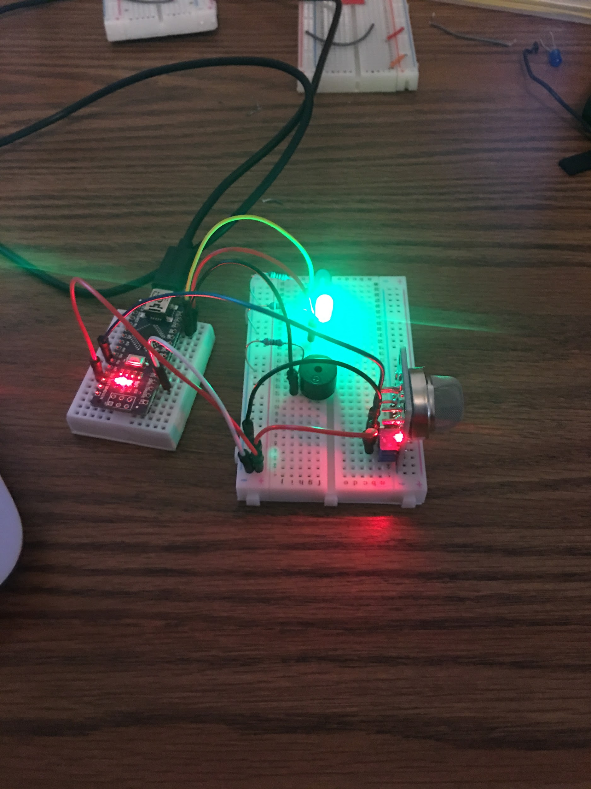
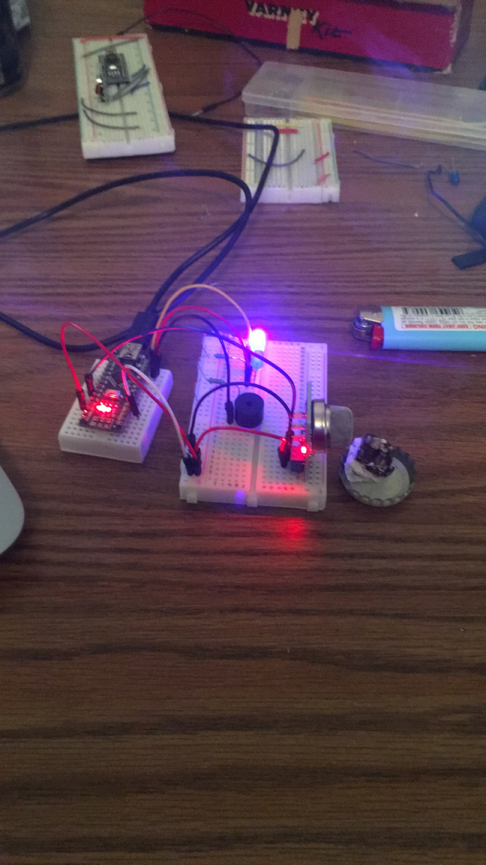
Implementation (Subtask 1.2) Design circuit and program for MQ-2 ionization sensor

Slide 19
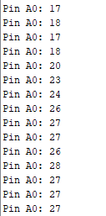
Implementation (Subtask 1.2) MQ-2 output.
Output is transmitted via analog pin 0.
Air particulate is measured in ppm (parts per million).
Threshold value set at 20 ppm.

Slide 20

Implementation (Subtask 1.2) MQ-2 video

Slide 21
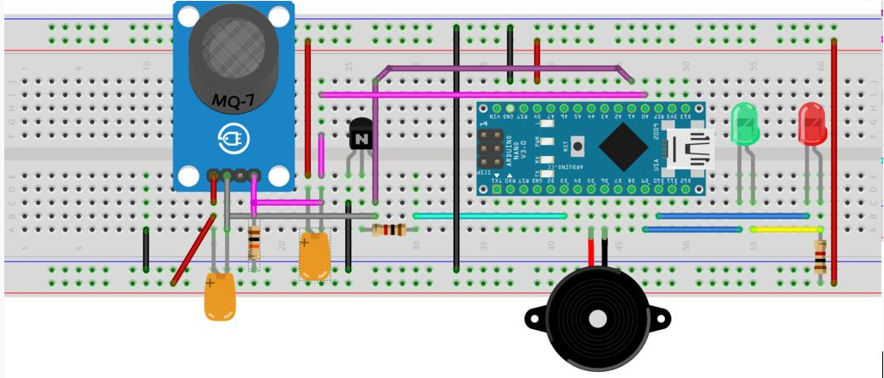
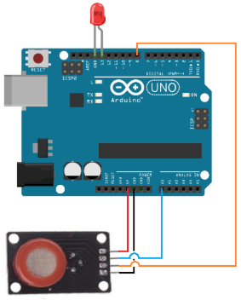
Implementation (Subtask 1.3) Design Circuit and program for MQ-7 CO sensor.

Slide 22
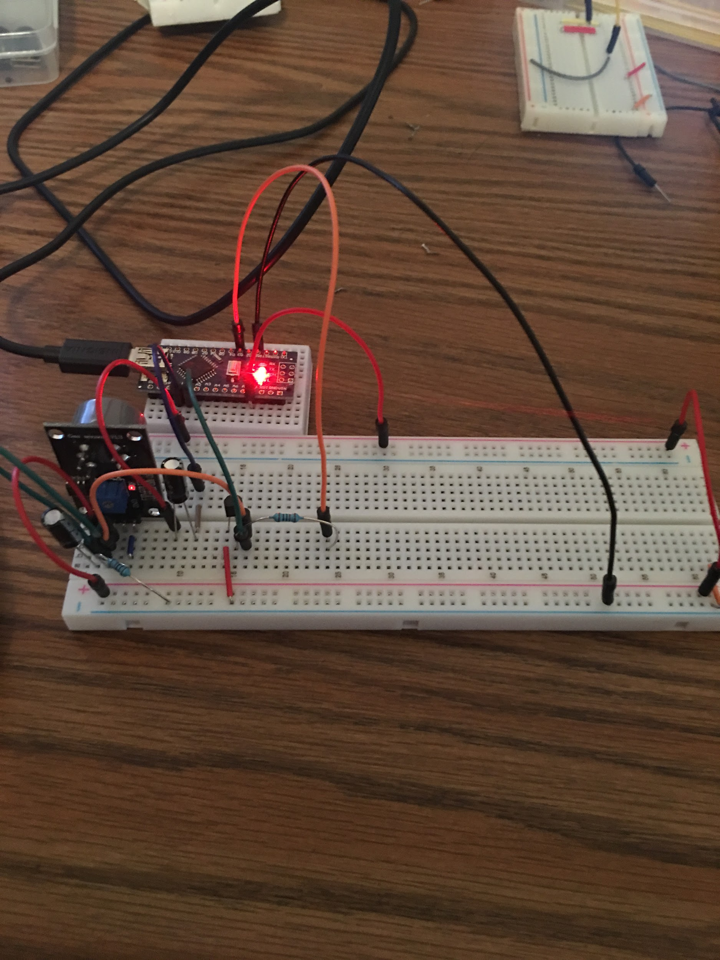
Implementation (Subtask 1.3) Design Circuit and program for MQ-7 CO sensor.

Slide 23
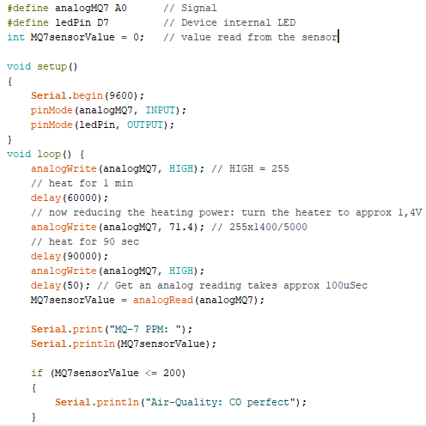
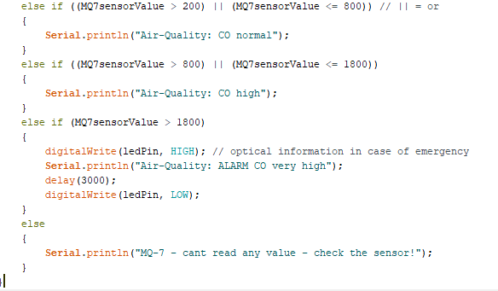
Implementation (Subtask 1.3) MQ-7 code.

Slide 24
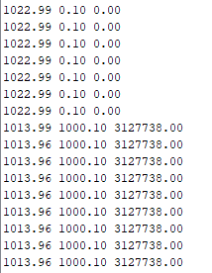
Implementation (Subtask 1.3) MQ-7 output.
CO threshold set to 1500 ppm.
Third column represents CO reading (ppm)

Slide 25
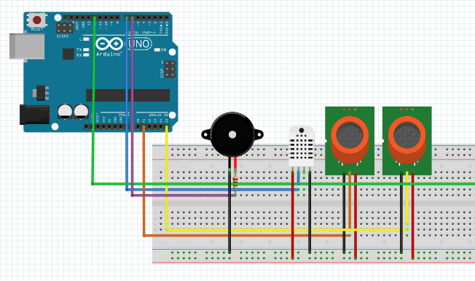
Implementation (subtask 1.4) Interface all sensors with arduino

Slide 26
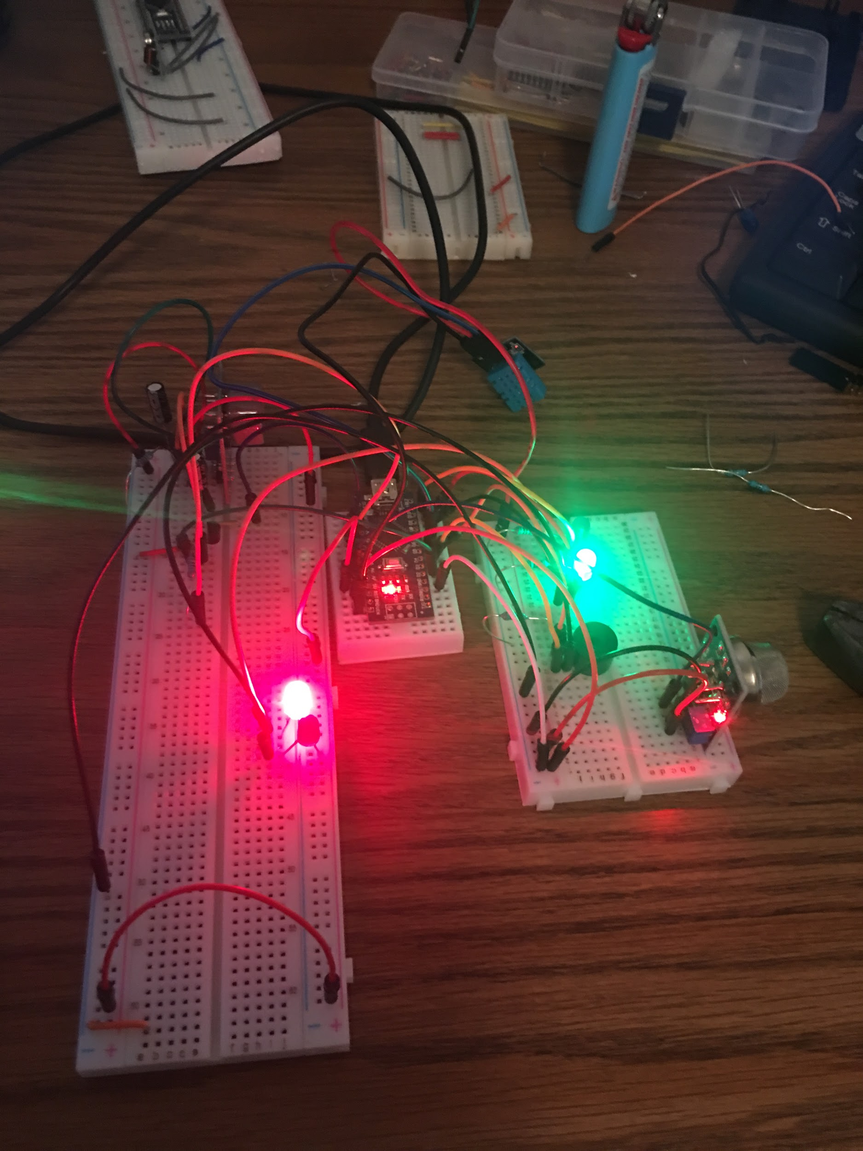
Implementation (subtask 1.4) Interface all sensors with arduino

Slide 27
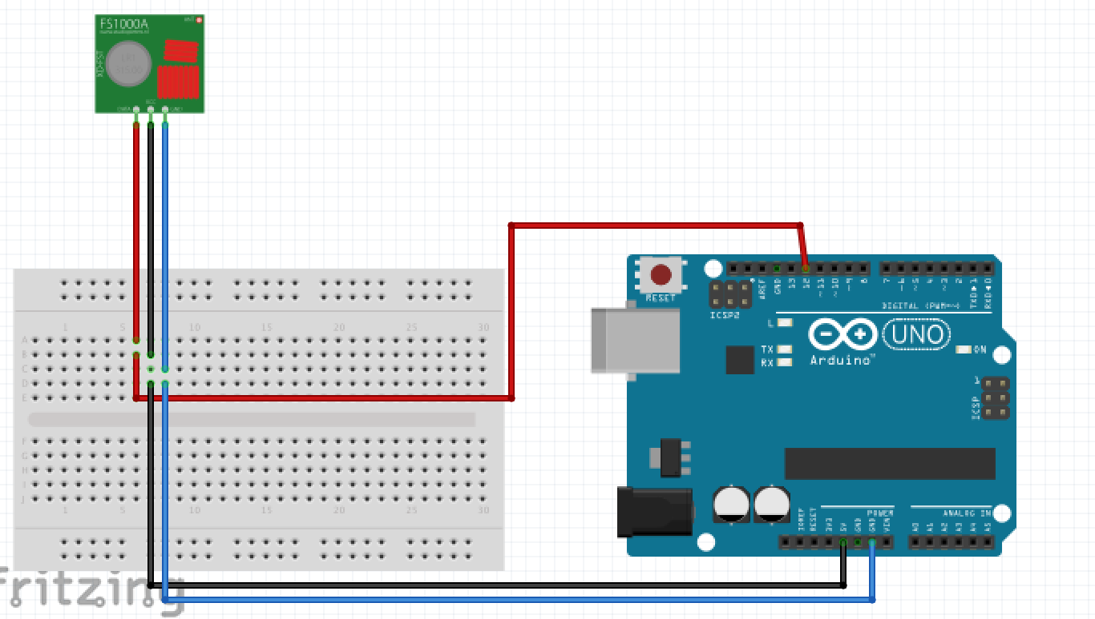
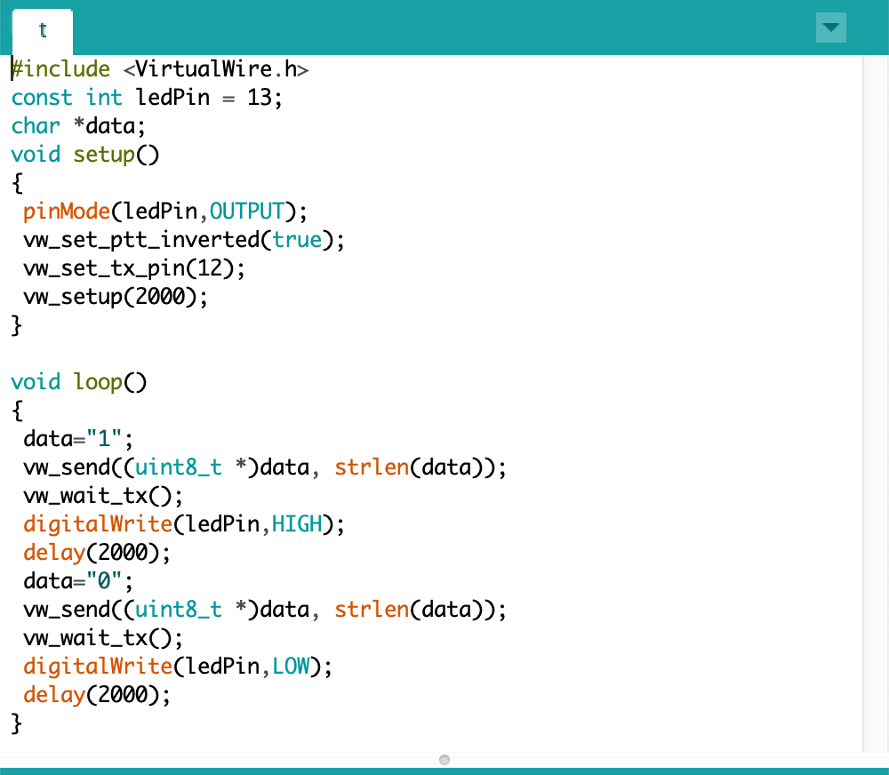
Implementation of task 2.1- 2.2 : Design of arduino and RF transmitter interface.

Slide 28
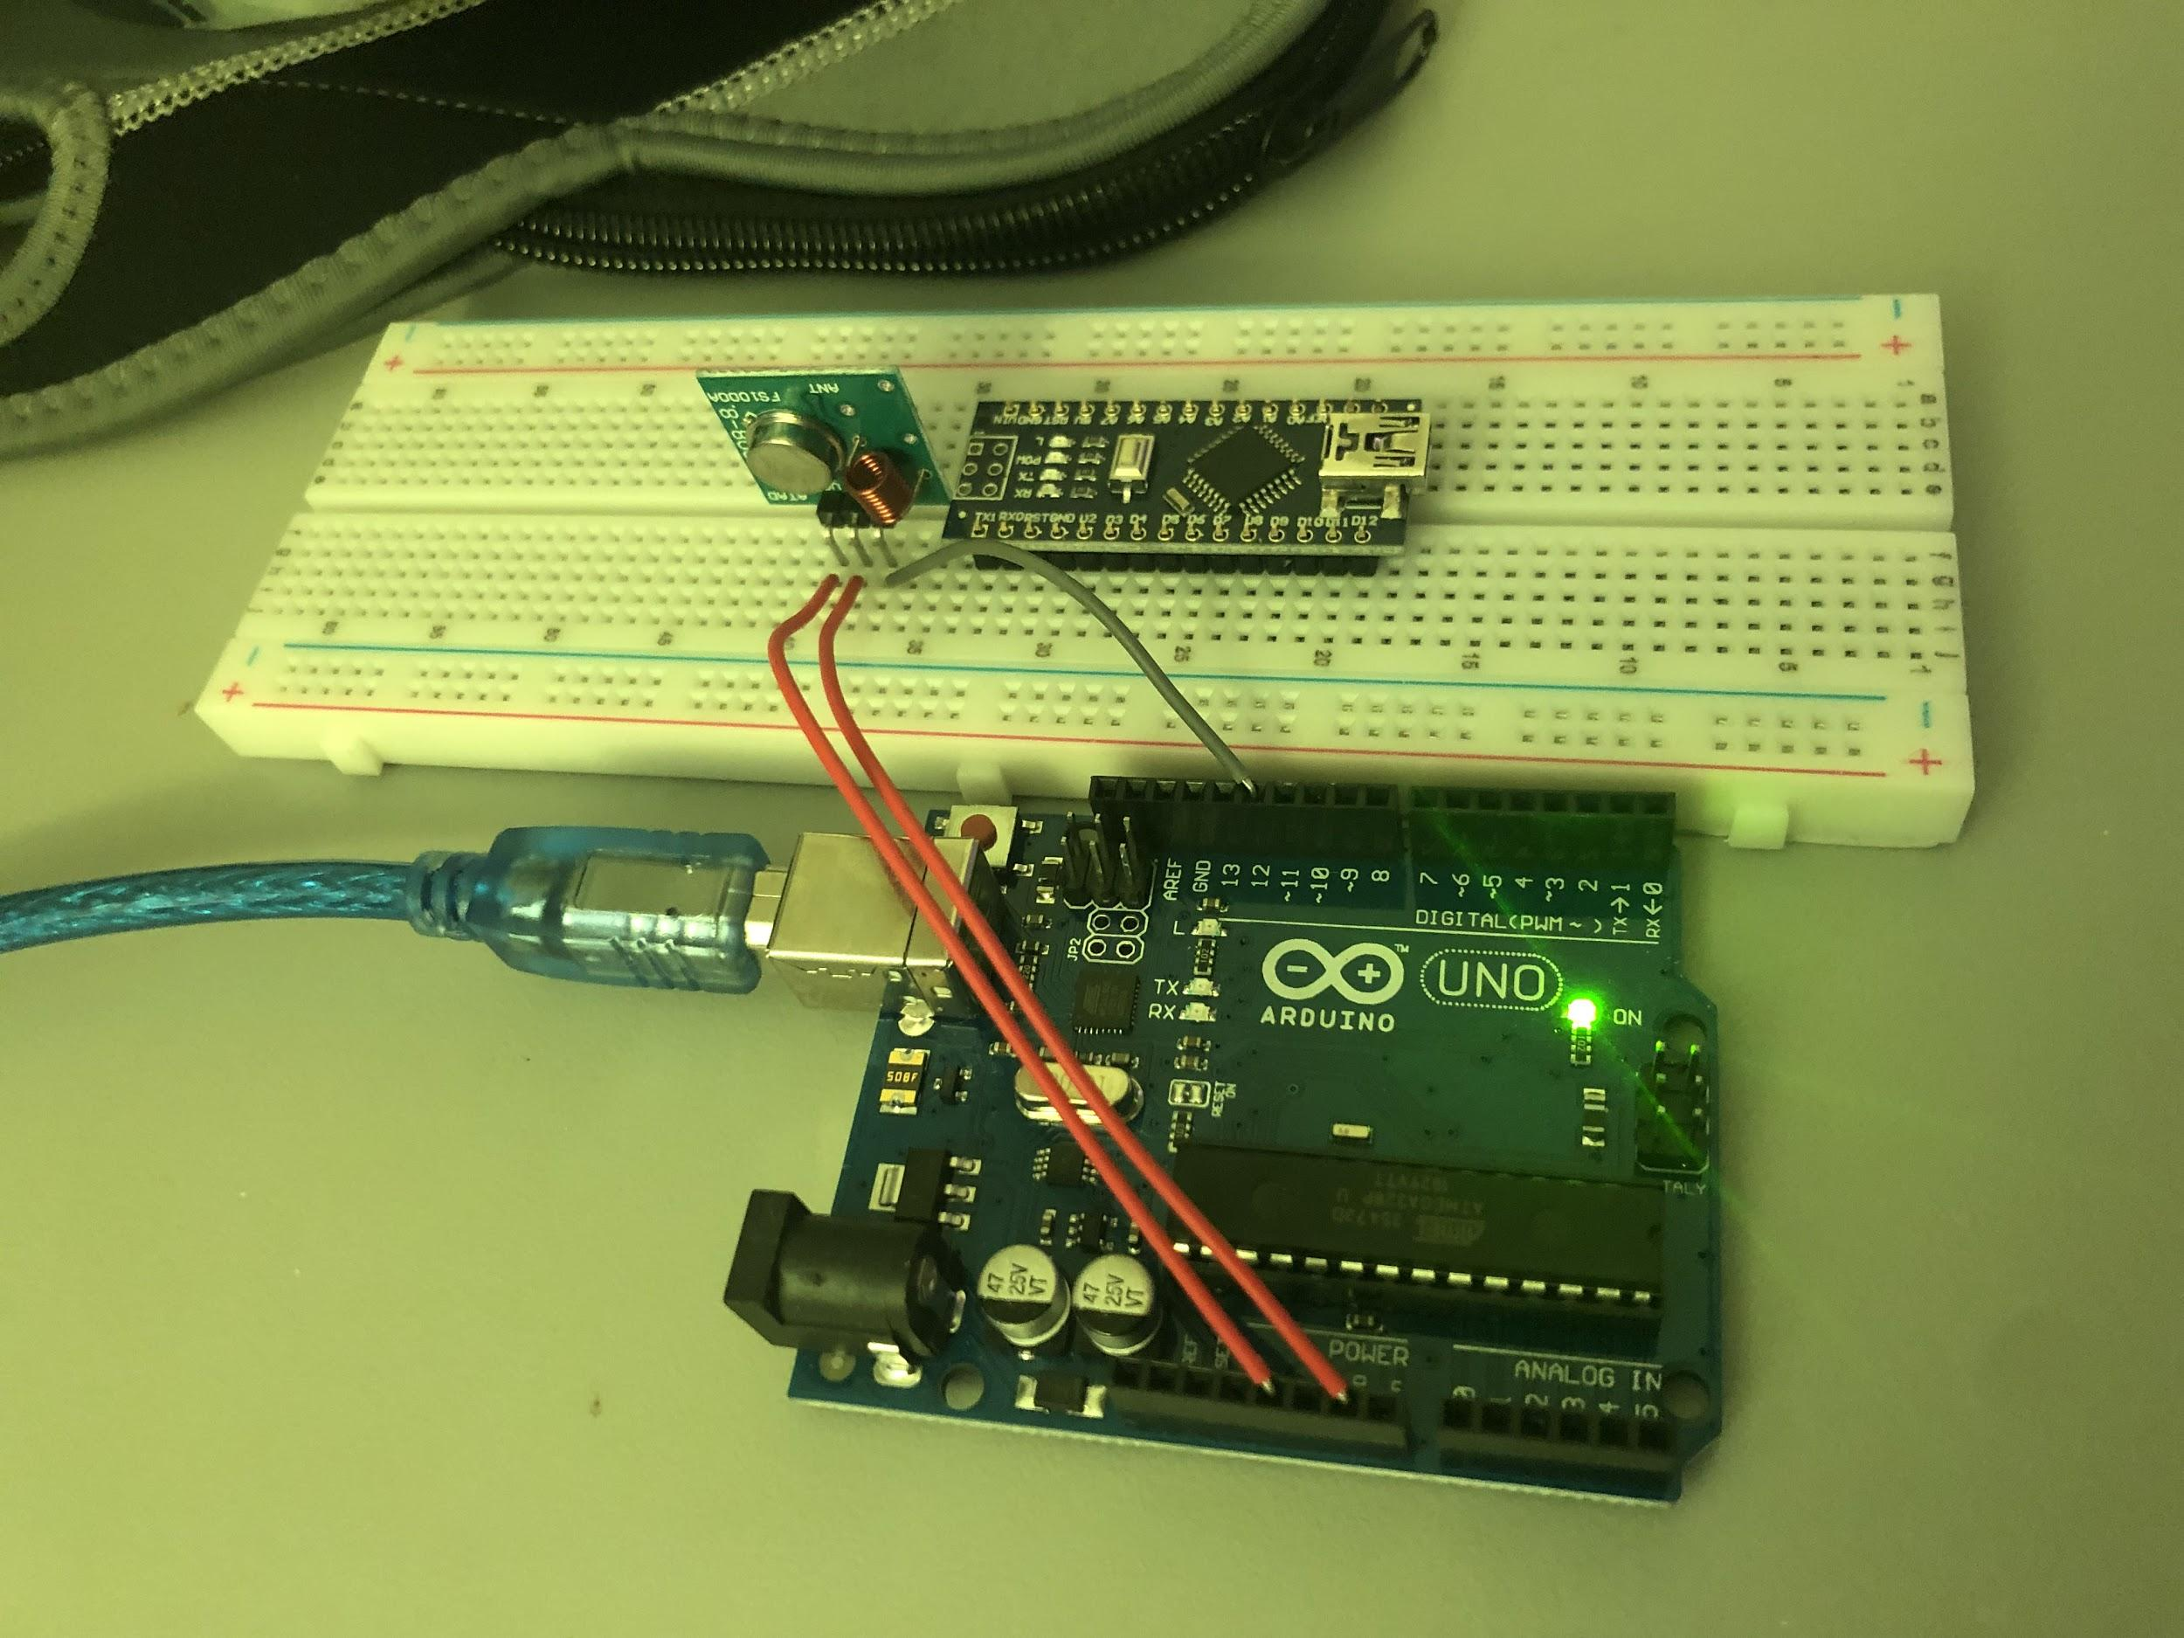
Implementation of subtask 2.1 - 2.2

Slide 29
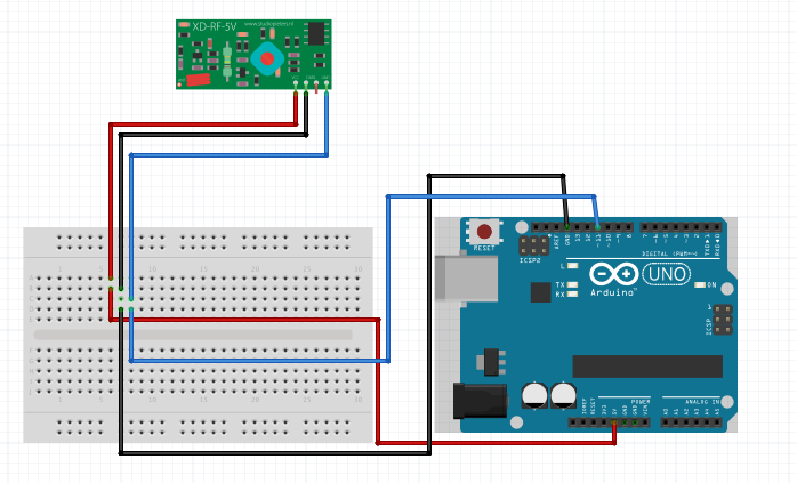
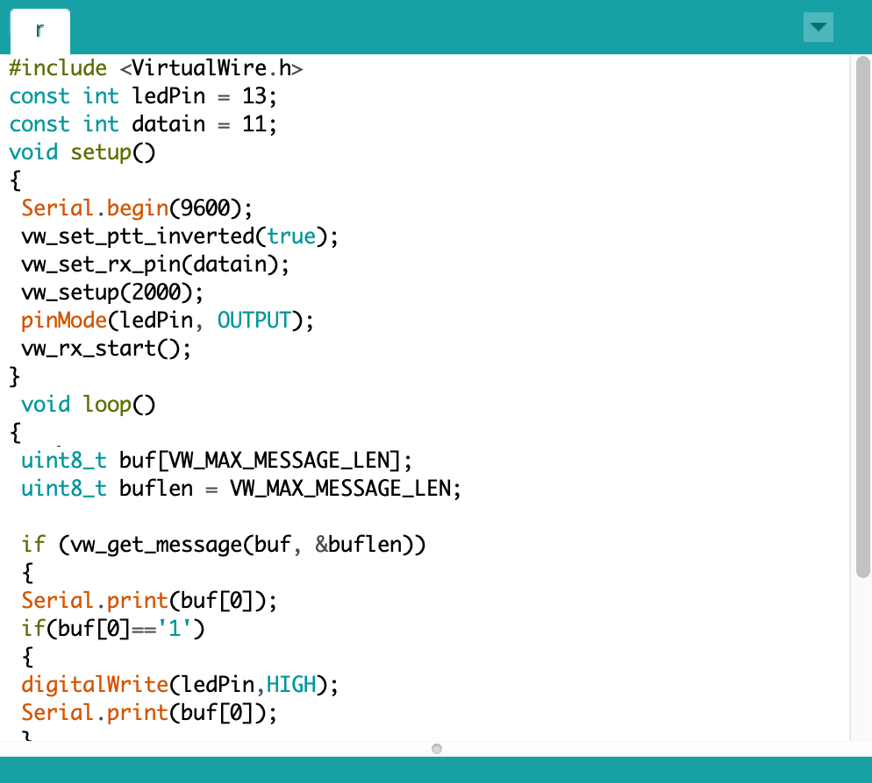
Implementation of task 2.3- 2.4 : Design of arduino and RF receiver interface.

Slide 30
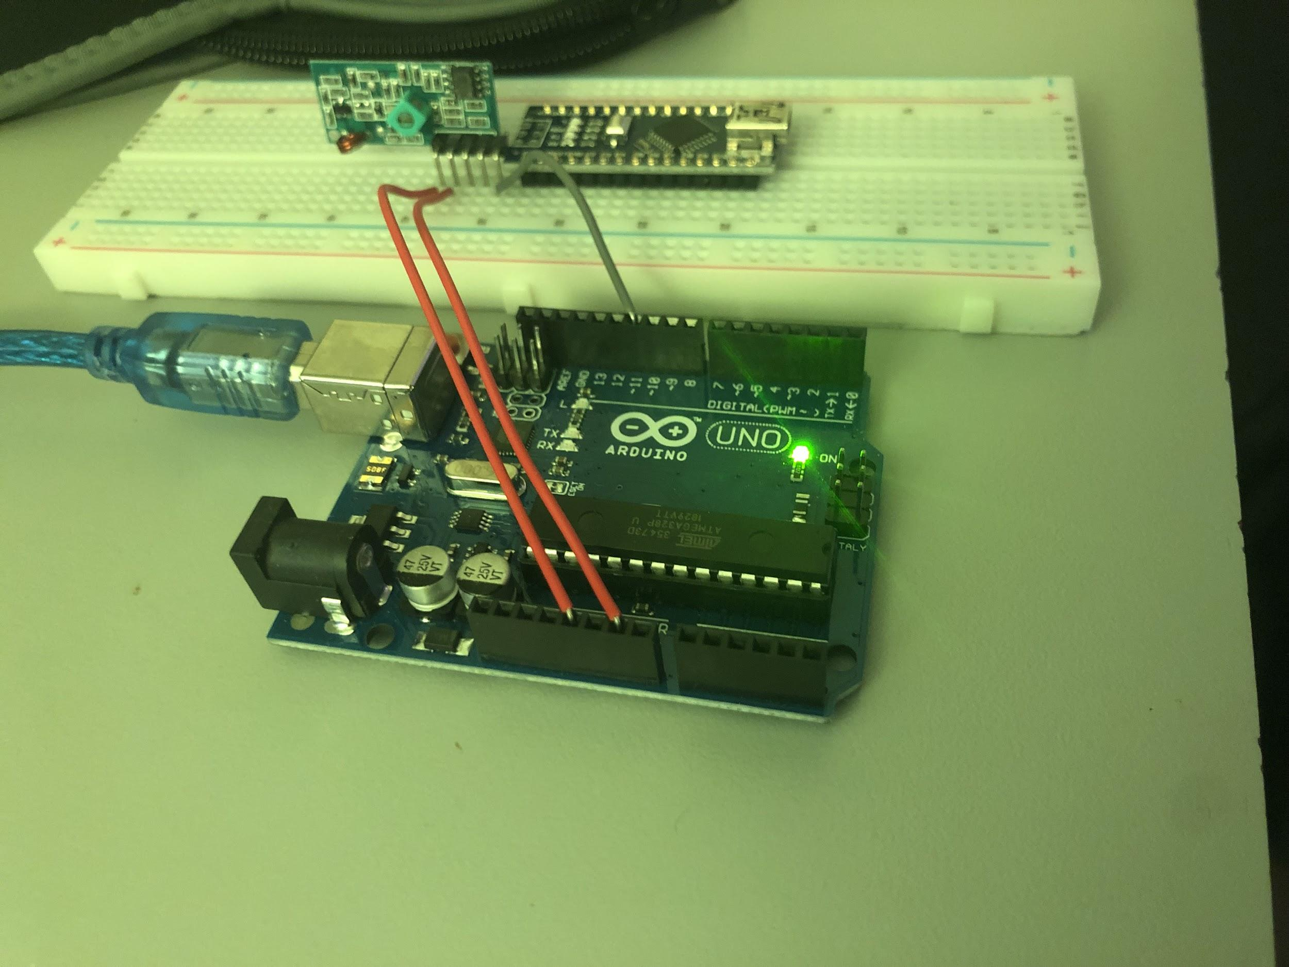
Implementation of subtask 2.1 - 2.2

Slide 31
Implementation (Subtask 2.3-2.4) video

Slide 32
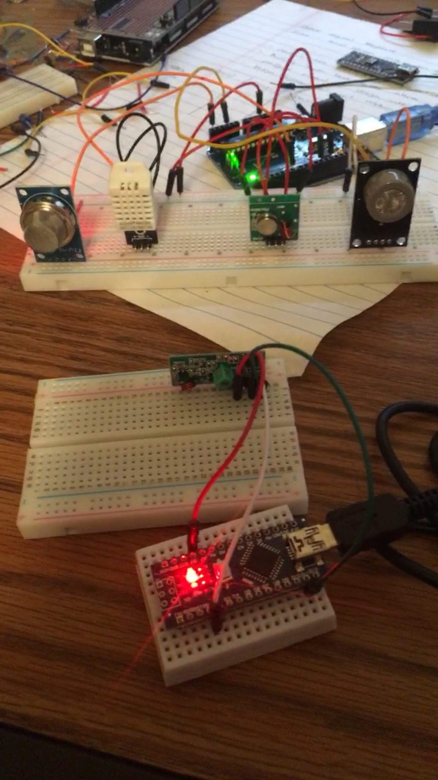
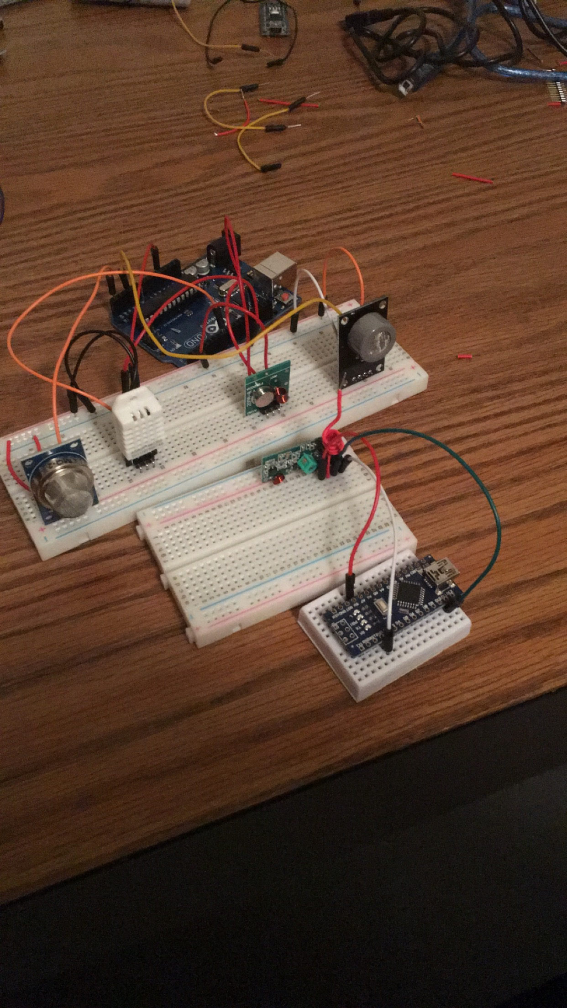
Implementation (Subtask 2.5) configure all sensors with RF receiver and transmitter.

Slide 33
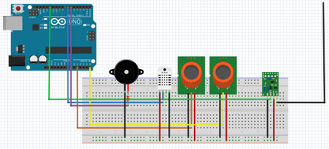
Implementation (Subtask 2.5) transmitter circuit diagram

Slide 34
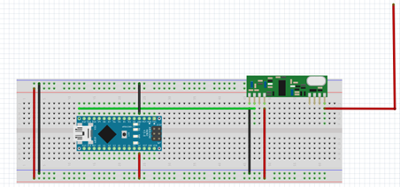
Implementation (Subtask 2.5) receiver circuit diagram

Slide 35
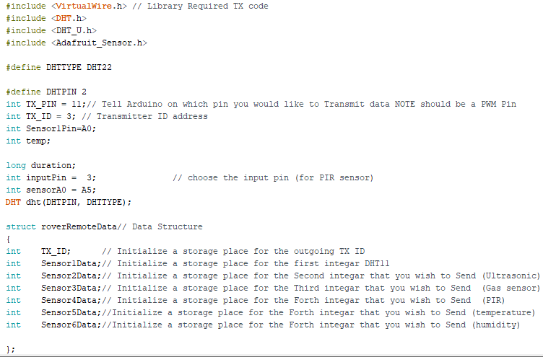
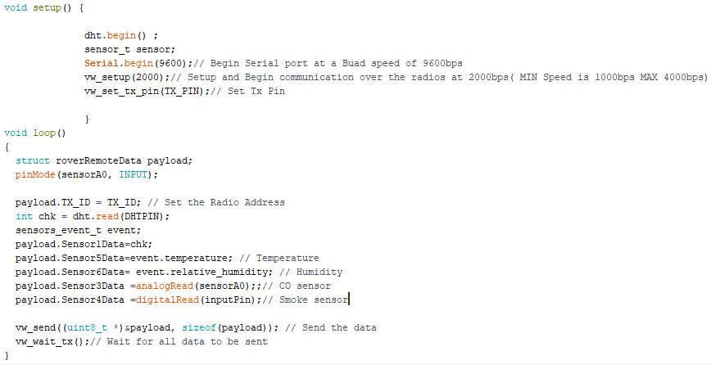
Implementation (Subtask 2.5) transmitter code utilizing data structure

Slide 36
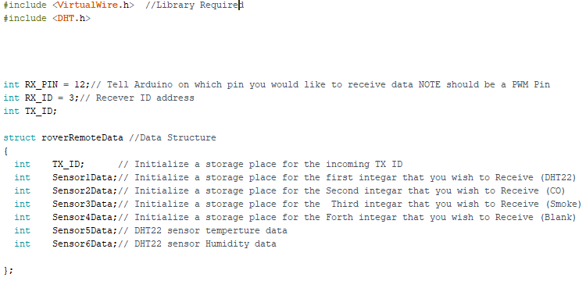
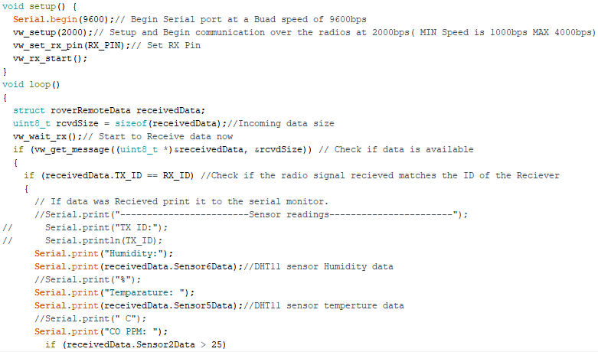
Implementation (Subtask 2.5) receiver code utilizing data structure

Slide 37
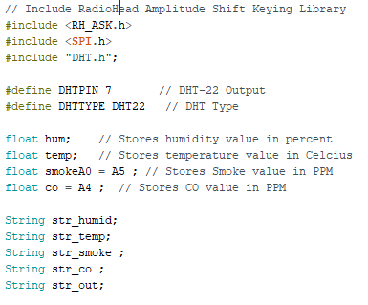
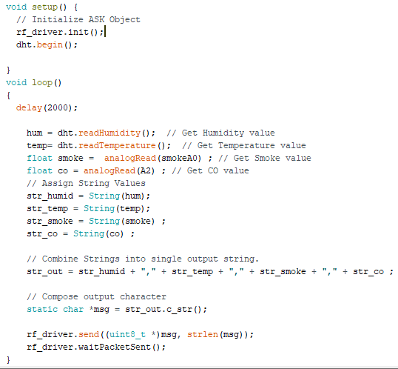
Implementation (Subtask 2.5) transmitter code utilizing array

Slide 38
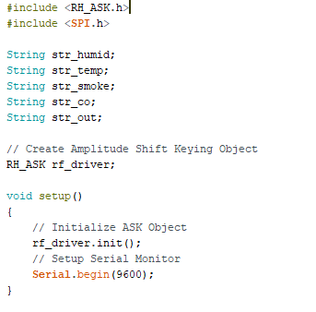
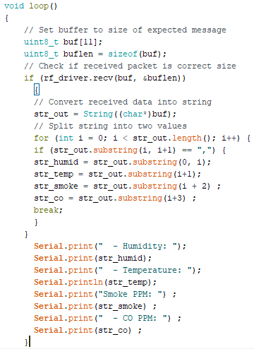
Implementation (Subtask 2.5) receiver code utilizing array

Slide 39
Implementation (Subtask 2.5) video of RF transmitter and receiver output.

Slide 40
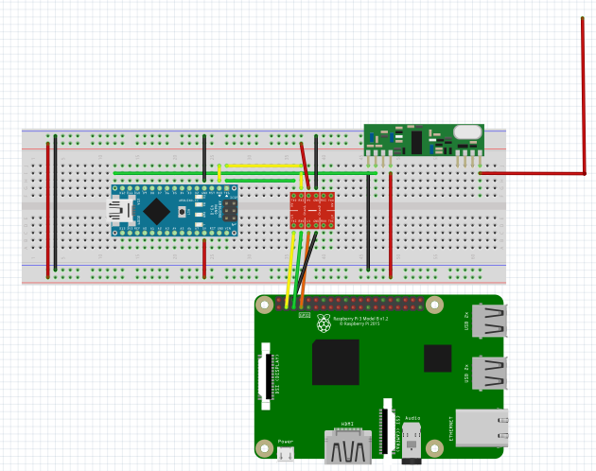
Implementation (Subtask 2.6) configure raspberry pie and RF receiver

Slide 41
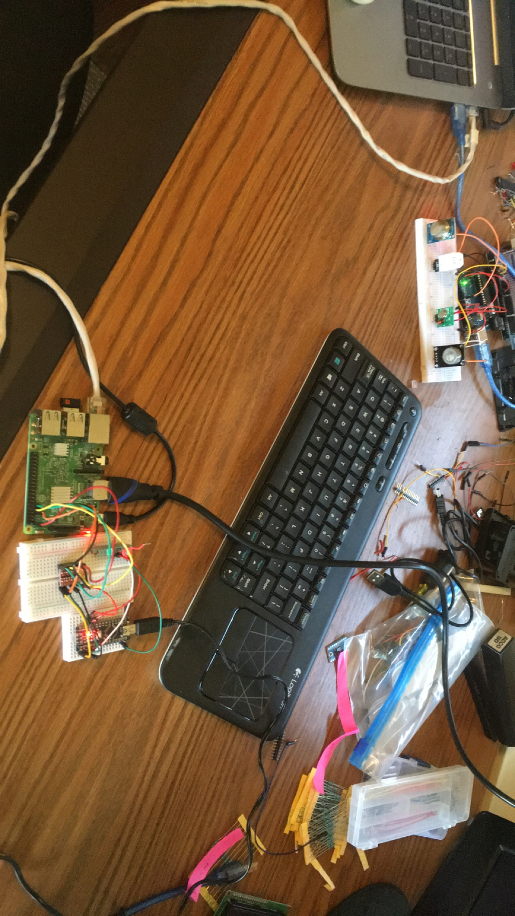
Implementation (Subtask 2.6) configure Raspberry Pi and RF receiver

Slide 42
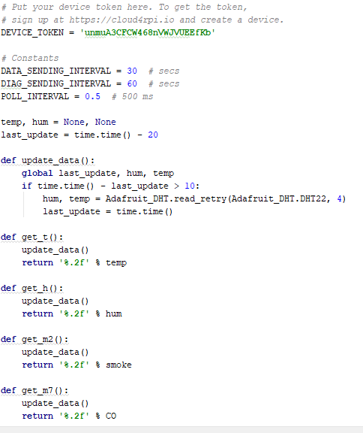
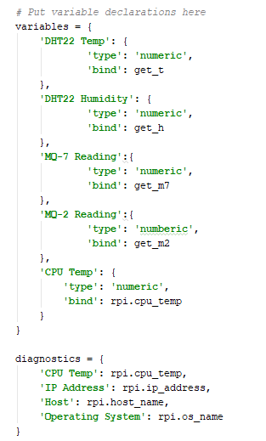
Implementation (Subtask 2.7) configure Raspberry Pi to receive node data

Slide 43
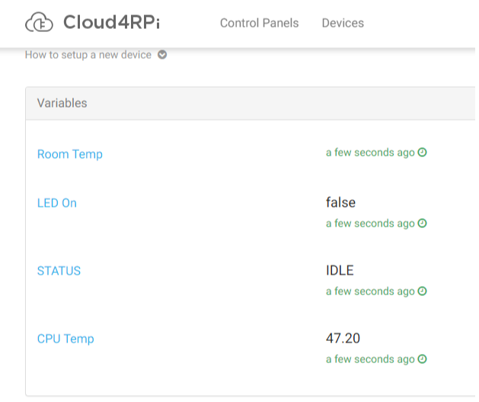
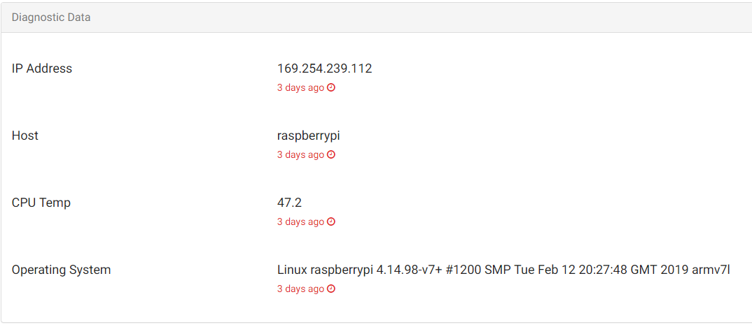
Implementation (Subtask 2.7) configure Raspberry Pi to receive node data

Slide 44
Implementation (Subtask 2.7) configure Raspberry Pi to receive node data

Slide 45
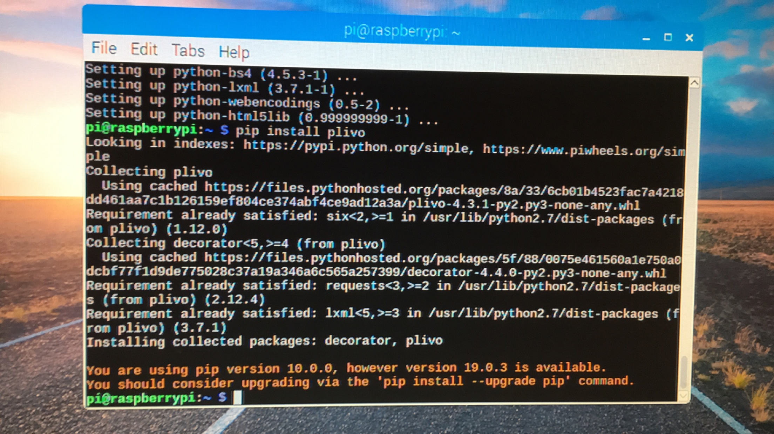
Implementation (subtask 5.1) Setup and install PLIVO on Raspberry Pi

Slide 46
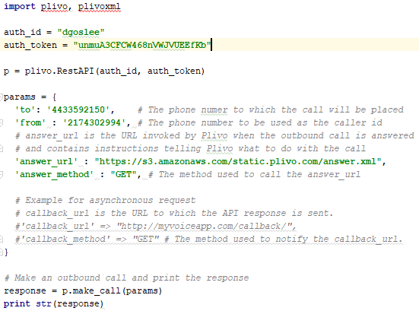
Implementation (subtask 5.2) Configure PLIVO with wireless sensor network

Slide 47
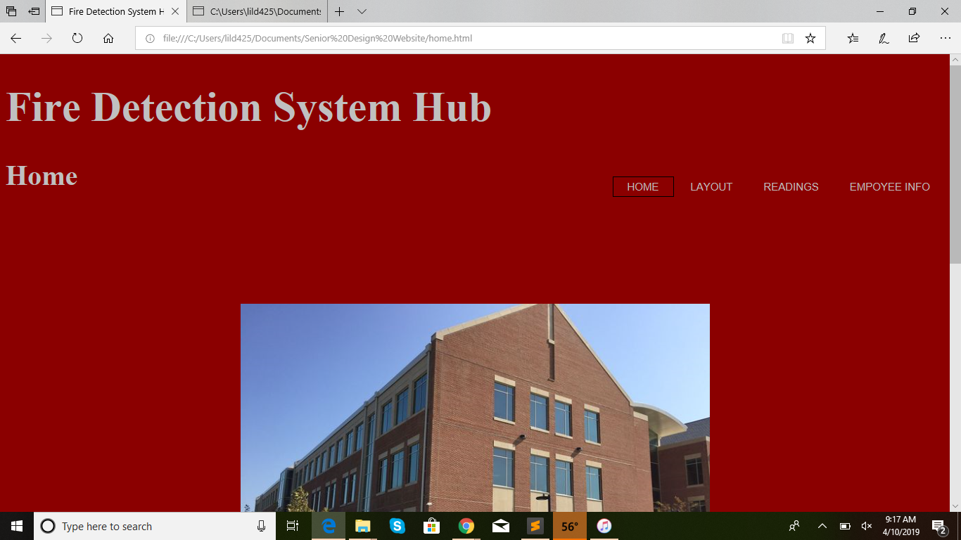
Implementation (subtask 3.1) website for main hub, home page

Slide 48
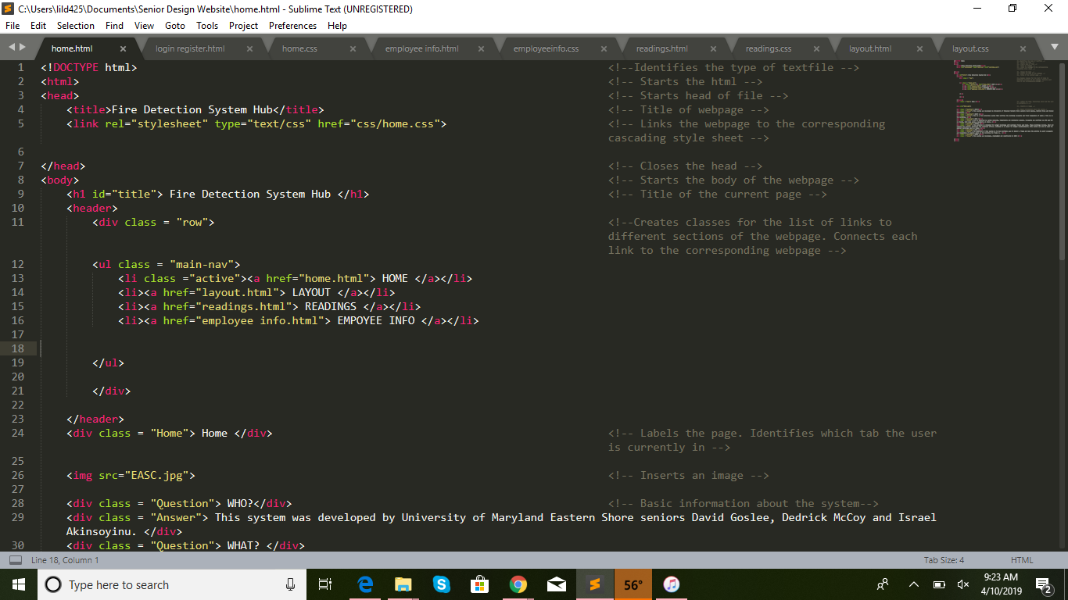
Implementation (subtask 3.1) Index for homepage

Slide 49

Implementation (subtask 3.1) css for homepage

Slide 50

Implementation (subtask 3.1) website for main hub, employee information page

Slide 51

Implementation (subtask 3.1) Employee info index file

Slide 52

Implementation (subtask 3.2) Login / Register page

